Slide 1

2019 Lariat Fleet Analysis
presented by Donald sun

Slide 2
What can Lariat do with its fleet, starting in 2019, to maximize profits and minimize costs?

Slide 3
Car Rental Fundamental Concepts
Key profit drivers
Economic growth
Rental price
Demand
Fleet Utilization
Key fleet cost drivers
Depreciation
Insurance
Fleet Size

Slide 4
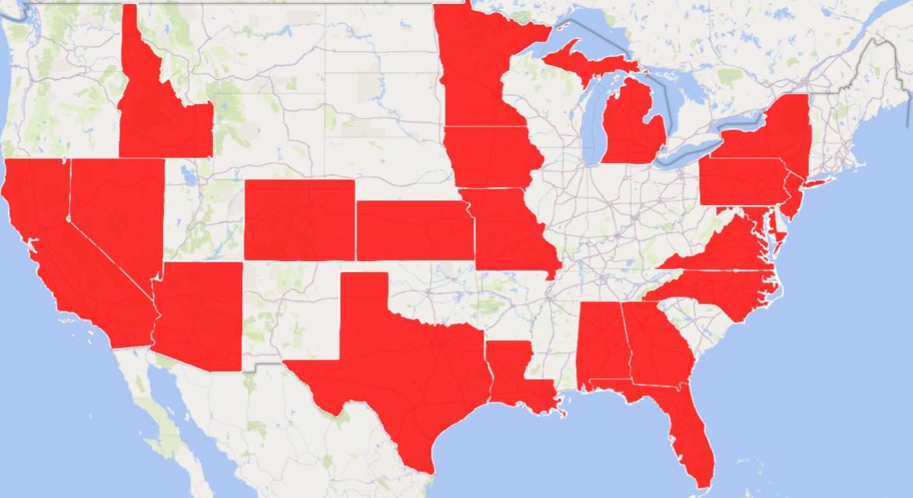
Supply and Demand
Demand Sources
Business Travel
Leisure Travel
Insurance Replacement
Lariat Supply
50 Branches in 22 States
4000 Vehicles in Fleet

Slide 5
Strategies to Optimize Profit : Cost
Benchmark) What can Lariat expect the market to look like in 2019?

Slide 6
2019 Forecasting
2019 figures are calculated by applying 2017 US Real GDP Growth for the Services (2.17%) sector, as well as 2017 US inflation data (2.14%)
GDP + Inflation
Inflation

Slide 7
Strategies to Optimize Profit : Cost
Benchmark) What can Lariat expect the market to look like in 2019?
1) What if Lariat replaced our most costly cars?

Slide 8
2016-2018 Make/Year Performance
New Cars cost less on average 0.49%
Revenue increases by 0.08%

Slide 9
2019 Forecast, Benchmark vs Strategy 1
Replace the 10% most expensive cars
Costs fall by almost 500k, y/y
Cost reduction by 1.4%
No change to revenue

Slide 10
Strategies to Optimize Profit : Cost
Benchmark) What can Lariat expect the market to look like in 2019?
1) What if Lariat replaced our most costly cars?
2) What if Lariat opened new branches?

Slide 11
2018 Actual Branch Performance
The worst branch (Las Vegas) earned 10.4% less than the best branch (St. Louis)
5.8% less than the average

Slide 12
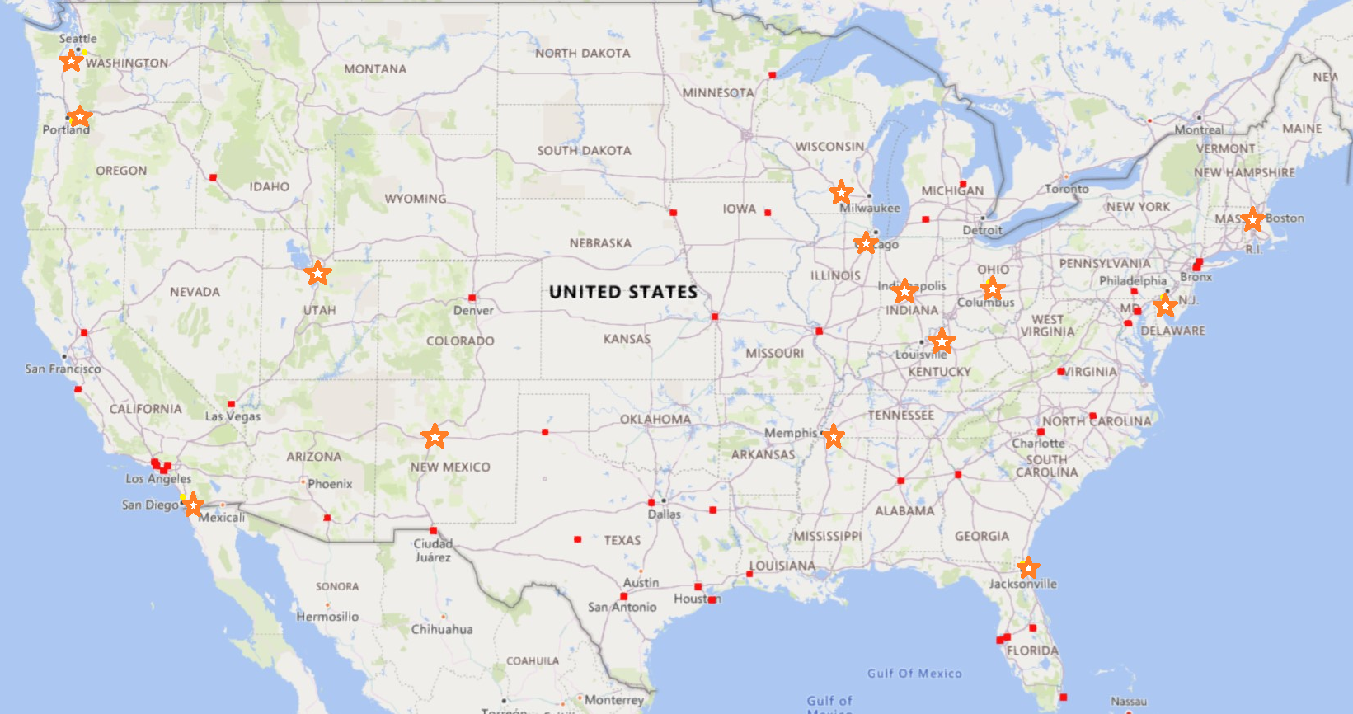
New Branch Locations

Slide 13
2019 Forecast, Benchmark vs Strategy 2
Expand network to increase customer base
50 to 64 Branches Total
Estimated cost of $750,000 per branch
Revenue Per Branch estimated as $1,280,000
Costs up by 31.1%
Profit up by 24.6%

Slide 14
Strategies to Optimize Profit : Cost
Benchmark) What can Lariat expect the market to look like in 2019?
1) What if Lariat replaced our most costly cars?
2) What if Lariat opened new branches?
3) What if Lariat reduces its fleet size?

Slide 15
2018 Fleet Actual Performance
Average Fleet Utilization is only 25.9%!

Slide 16
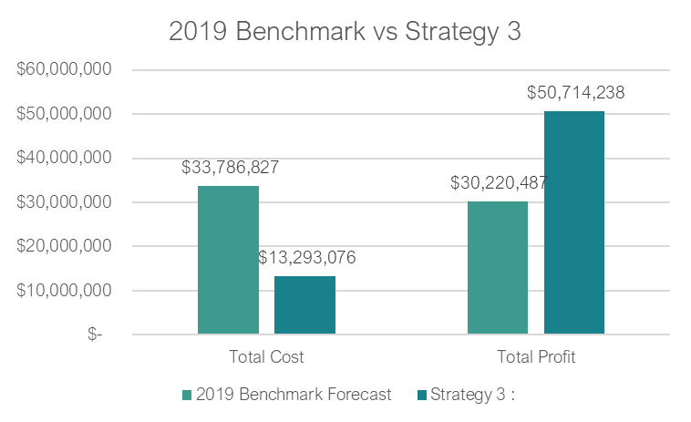
2019 Forecast, Benchmark vs Strategy 3
Reduce the size of the fleet by 2350 cars (58.8%)
Costs down by 154%
Profits up by 59.6%
Fleet Utilization at 65%
Revenue unchanged

Slide 17
Strategies to Optimize Profit : Cost
Benchmark) What can Lariat expect the market to look like in 2019?
1) What if Lariat replaced our most costly cars?
2) What if Lariat opened new branches?
3) What if Lariat reduces its fleet size?
4) What if Lariat reduces prices?

Slide 18
2019 Forecast, Benchmark vs Strategy 4
Reduce prices to encourage customer demand
Effect on demand will depend heavily on competitors
Estimates based on 10% demand increase for $10 discounted rate.
Profit increases by 6.8%
Reduces revenue per branch down 4.2%

Slide 19
Strategies to Optimize Profit : Cost
Benchmark) What can Lariat expect the market to look like in 2019?
1) What if Lariat replaced our most costly cars?
2) What if Lariat opened new branches?
3) What if Lariat reduces its fleet size?
4) What if Lariat reduces prices?
5) What if Lariat entered the Insurance Replacement market?

Slide 20
2019 Forecast, Benchmark vs Strategy 5
Insurance Replacement Market
Long rental length
Current Longest : 7 days
Insurance : 11.5 Days Avg
27% Revenue for competition
Profit up by 78.3%
Cost unchanged
Fleet utilization 26.4% to 36.2%

Slide 21
Strategies to Optimize Profit : Cost
Benchmark) What can Lariat expect the market to look like in 2019?
1) What if Lariat replaced our most costly cars?
2) What if Lariat opened new branches?
3) What if Lariat reduces its fleet size?
4) What if Lariat reduces prices?
5) What if Lariat entered the Insurance Replacement market?
6) What if Lariat did all of the above?

Slide 22
Strategies Overview
Cost Reducing
Maximum Profit
Revenue Increasing

Slide 23
Recommendation for 2019
1) Expand Lariat Branches into nearby major cities.
14 Candidate Locations
2) Cut fleet size to achieve 65% utilization rate
2350+/- Cars removed, depending on other factors
850+/- for strategy 6
3) Explore methods to grow demand
Advertising, discounts, etc.
Insurance Replacement Market
Combined Profit Growth is 163%!

Slide 24
Source Workbook
https://drive.google.com/file/d/1GuuuwQjHxyKdlsh_zWqlkjUs9D6MpEYw/view?usp=sharing

